Slide 1
The Battle of Neighborhoods
Capstone Project

Slide 2

Introduction
Imagine a person has been living in East York, Toronto for fifteen years and now he has to leave East York and relocate to NY for a change in his job location.
This person got used to living a particular lifestile, where he likes to go to Italian restaurants and loves going to parks and now he wants to choose a neighborhood that has all the things he loves from his past area.

Slide 3
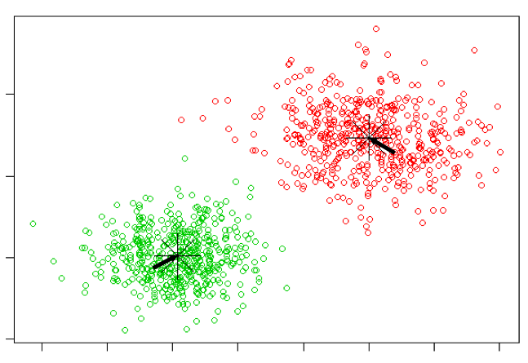
Process
For this project a k-mean clustering algorithm was used to cluster the neighborhood based on their similarities.
The objective is to figure out the optimal cluster size by doing some exploratory analysis on different clusters and trying to observe their similarities.

Slide 4
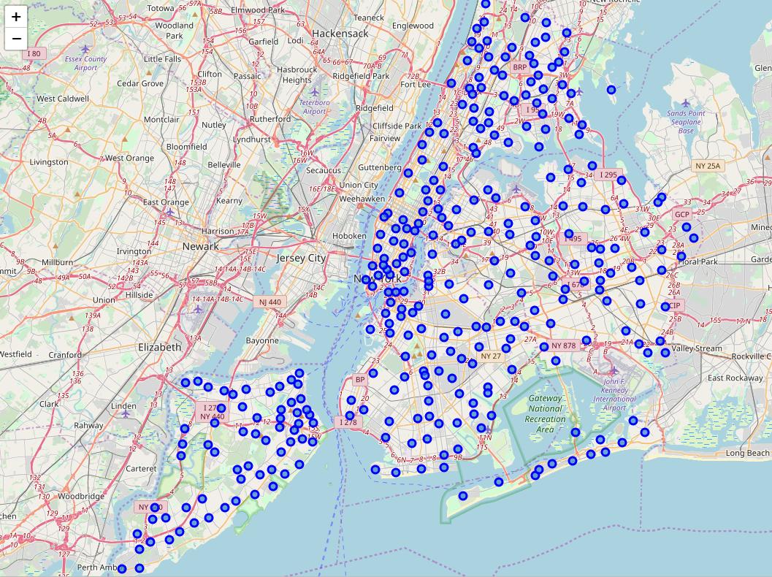
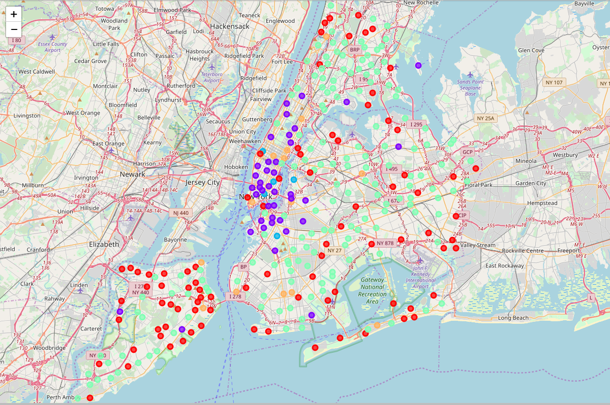
Exploratory analysis - Clusters
Before Clustering
After Clustering
NY Zip codes with the assigned cluster label

Slide 5
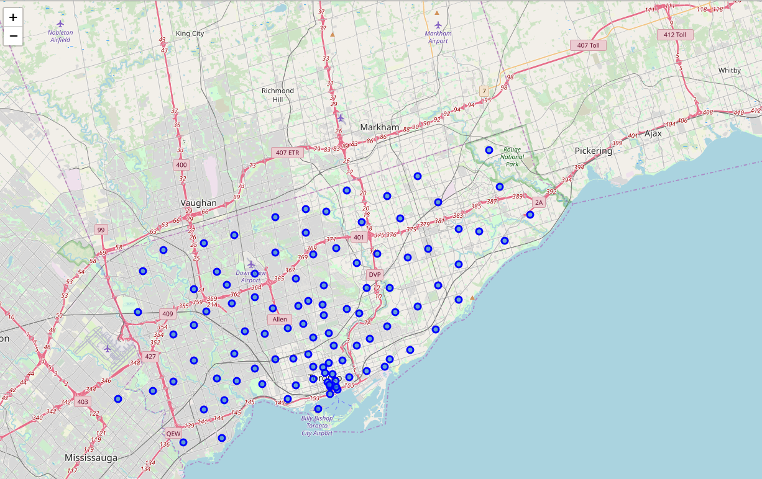
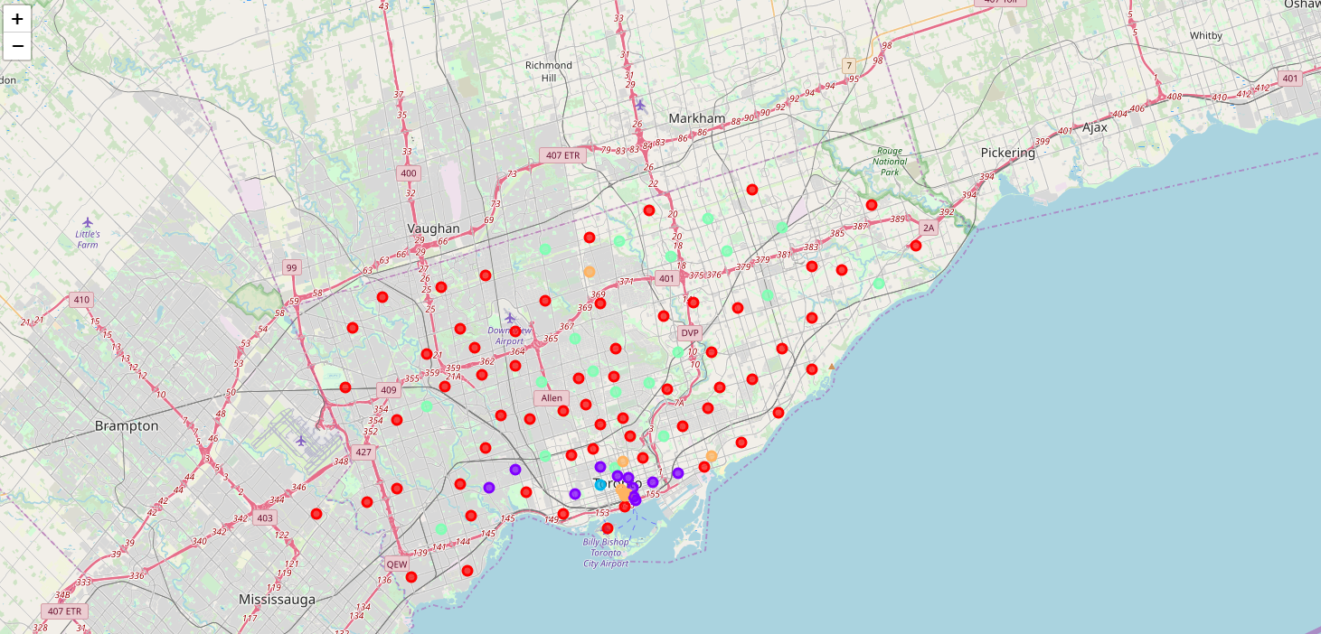
Exploratory analysis - Clusters
Before Clustering
After Clustering
Toronto Zip codes with the assigned cluster label

Slide 6

Finding & Summary
Some of the limitations found in this project where that there was a huge feature space but very few number of samples. It would be beneficial to add more data to improve our analysis.
We identified some outlier in our data. For more detailed analysis we would need to filter the outliers.
In this case we only used k mean algorithm but probably other algorithms ca be applied to compare the results and choose the best approach to use for this specific problem.

